Slide 1



ANTS VS BEETLES
OOSD ASSIGNMENT ONE
S3668031
s3641235
S3568521
s3638336

Slide 2
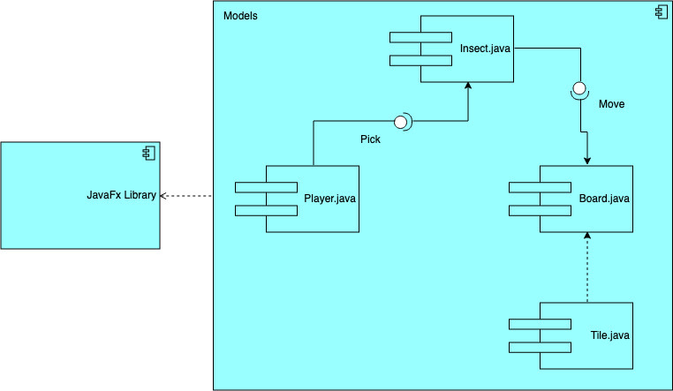
Component
Diagram

Slide 3
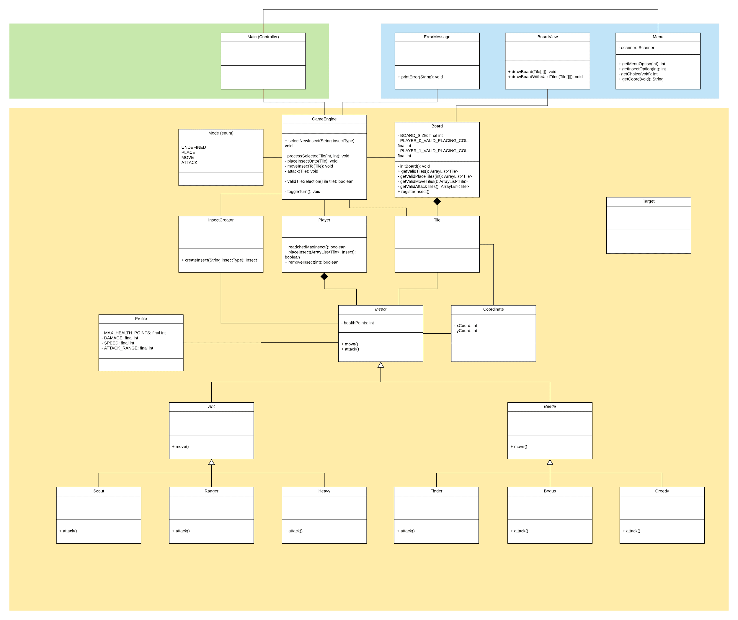
System Design

Slide 4
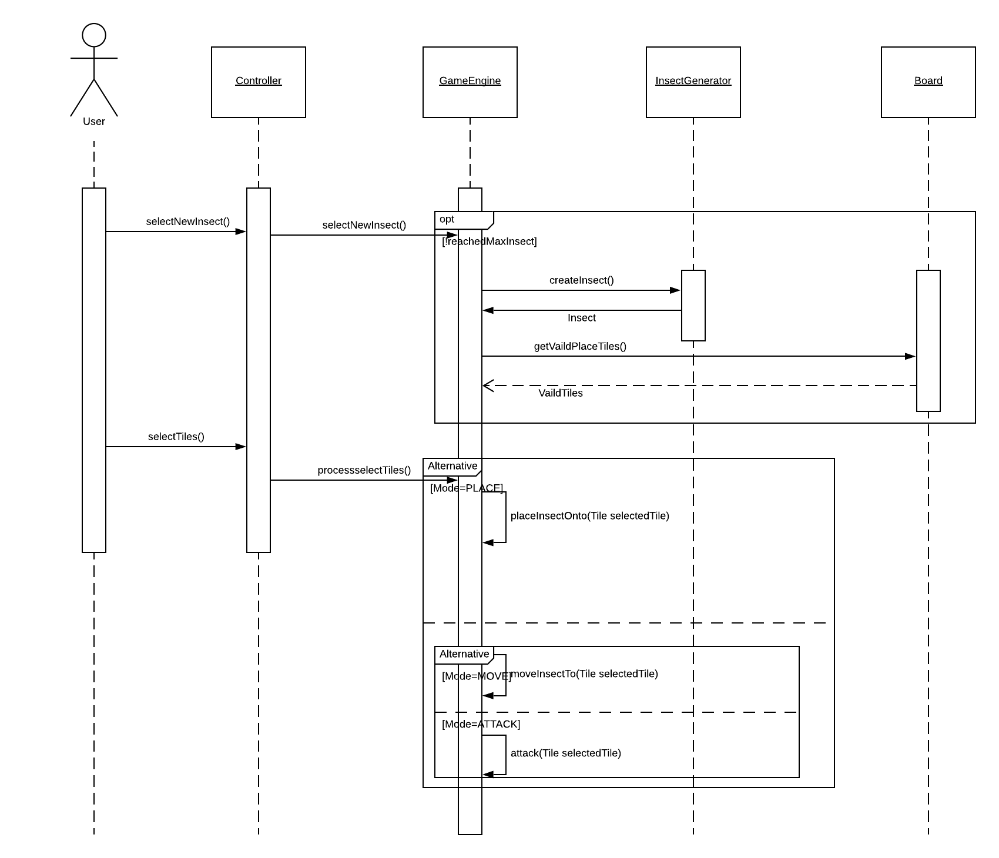
Analysis Design
and Gameplay
(Sequence Diagram)

Slide 5
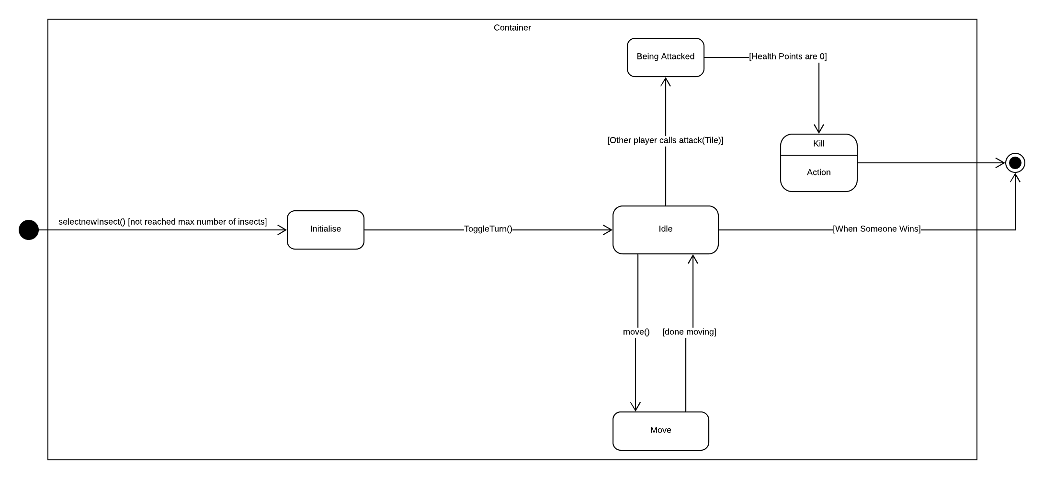
Analysis Design
and Gameplay
(State Diagram)

Slide 6
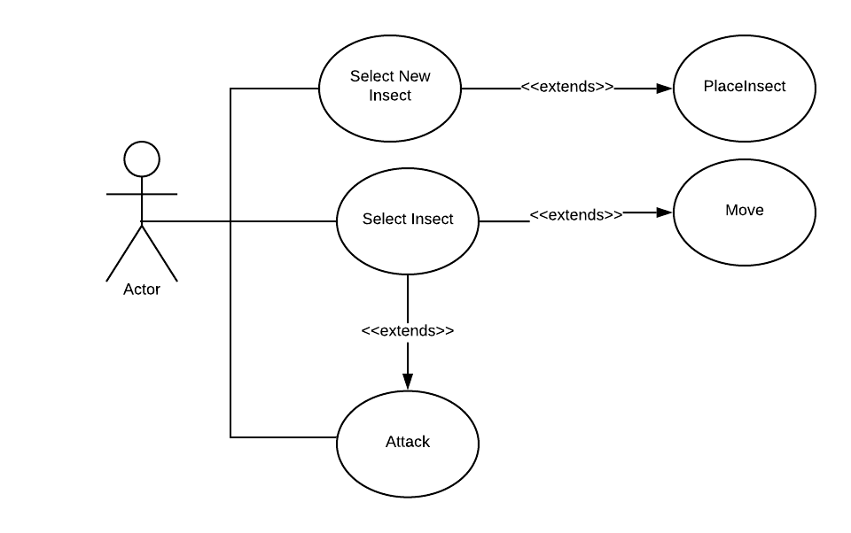
Analysis Design
and Gameplay
(Use Case Diagram)

Slide 7
DEMO

